Slide 1


Assembly Language for x86 Processors 7th Edition
Kip R. Irvine
Lecture 5: Procedures
(c) Pearson Education, 2015. All rights reserved. You may modify and copy this slide show for your personal use, or for use in the classroom, as long as this copyright statement, the author's name, and the title are not changed.
Last update: 11/05/2020

Slide 2
Lecture Overview
Recap
Stack Operations
Defining and Using Procedures
Irvine, Kip R. Assembly Language for x86 Processors 7/e, 2015.

Slide 3
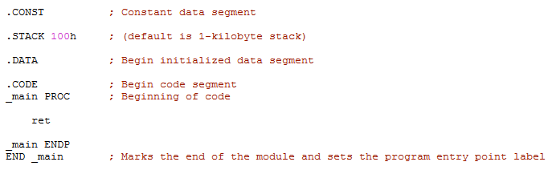
Program Layout – Directives
REM Lecture 5

Slide 4
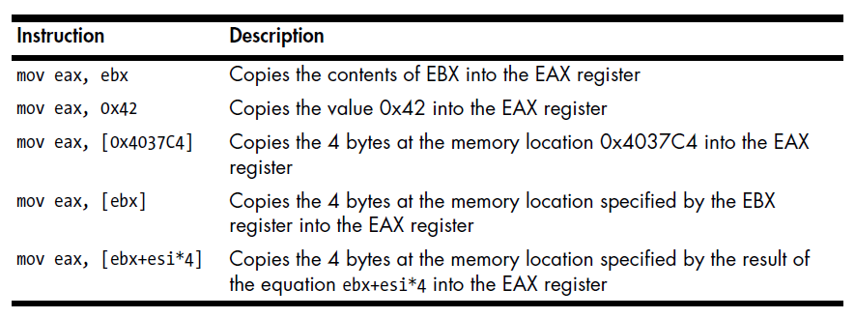

Assembly Instructions
Move Instruction
REM Lecture 5

Slide 5
Assembly Instructions
Load Effective Address Instruction
Instruction | Description
lea ax, [bx] | Puts value in bx into ax
lea bx, [bx + 3] | Increases value in bx by 3
lea eax, [ebx + 8] | Puts value of (ebx + 8) into eax
lea ecx, [0 + 4*eax + eax] | Multiplies value in eax by 5 and puts it into ecx
lea esi, [ebx + 8*eax + 4] | Puts value of (ebx + 8*eax + 4) into esi
REM Lecture 5

Slide 6
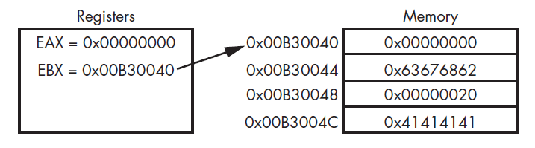
Assembly Instructions
EBX used to access memory
REM Lecture 5

Slide 7
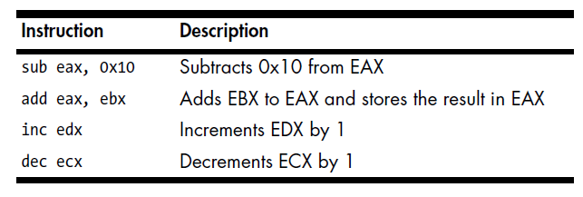
Assembly Instructions
Arithmetic Instructions
REM Lecture 5

Slide 8
Stack Operations
Function call
Runtime Stack
PUSH Operation
POP Operation
PUSH and POP Instructions
Using PUSH and POP
Related Instructions
Irvine, Kip R. Assembly Language for x86 Processors 7/e, 2015.

Slide 9
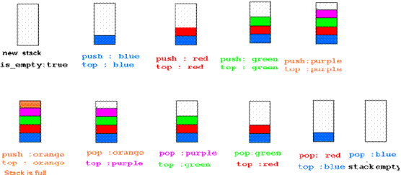
The Stack
Stores memory for functions, local variables and flow control
Push items onto stack
Pop items off stack
Has LIFO structure
REM Lecture 5

Slide 10
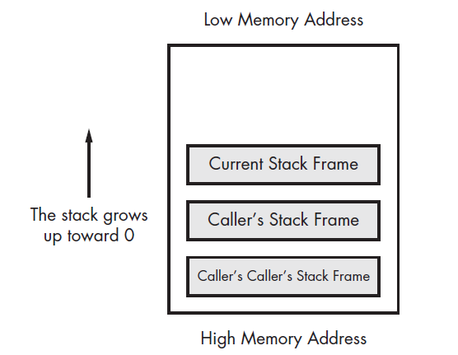
The Stack
x86 Stack Layout
ESP
REM Lecture 5

Slide 11
Function Calls
A function is a block of code within a program
Each function performs a specific task
Program calls a function and transfers execution flow control to it
When function completes execution, control is returned to next program instruction after call
REM Lecture 5

Slide 12
Organisation of Function
Function contains prologue and epilogue
Prologue prepares stack and registers for use within the function
Epilogue restores states of stack and registers prior to call
Prologue and Epilogue can contain buffer overflow protection code
Prologue
Body
Epilogue
REM Lecture 5

Slide 13
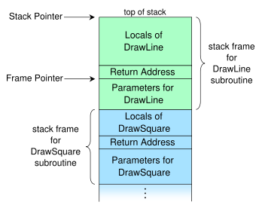
Function Calls – What happens?
ESP
EBP
DrawSquare(parameters)
. . .
call DrawLine(parameters)
<return here>
. . .
DrawLine(parameters)
. . .
return
REM Lecture 5

Slide 14
Function Calls – Interaction with Stack
Call function with: call memory_location
(memory_location is start of called function)
Current value in EIP pushed onto stack;
EIP set to memory_location
Items associated with each called function are stored in a stack frame
ESP (Stack Pointer) points to top item;
EBP (Base Pointer) points to start of frame
REM Lecture 5

Slide 15
Runtime Stack
Imagine a stack of plates . . .
  plates are only added to the top
  plates are only removed from the top
  LIFO structure
Irvine, Kip R. Assembly Language for x86 Processors 7/e, 2015.

Slide 16
Runtime Stack
Managed by the CPU, using two registers
  SS (stack segment)
  ESP (stack pointer) *
* SP in Real-address mode
Irvine, Kip R. Assembly Language for x86 Processors 7/e, 2015.

Slide 17
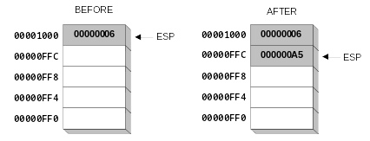
PUSH Operation (1 of 2)
A 32-bit push operation decrements the stack pointer by 4 and copies a value into the location pointed to by the stack pointer.
Irvine, Kip R. Assembly Language for x86 Processors 7/e, 2015.

Slide 18
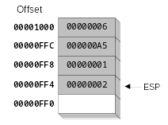
PUSH Operation (2 of 2)
Same stack after pushing two more integers:
The stack grows downward. The area below ESP is always available (unless the stack has overflowed).
Irvine, Kip R. Assembly Language for x86 Processors 7/e, 2015.

Slide 19
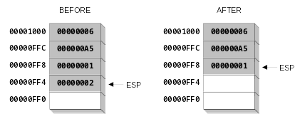
POP Operation
Copies value at stack[ESP] into a register or variable.
Adds n to ESP, where n is either 2 or 4.
  value of n depends on the attribute of the operand receiving the data
Irvine, Kip R. Assembly Language for x86 Processors 7/e, 2015.

Slide 20
PUSH and POP Instructions
PUSH syntax:
  PUSH r/m16
  PUSH r/m32
  PUSH imm32
POP syntax:
  POP r/m16
  POP r/m32
Irvine, Kip R. Assembly Language for x86 Processors 7/e, 2015.

Slide 21
Using PUSH and POP
Save and restore registers when they contain important values. PUSH and POP instructions occur in the opposite order.
push esi ; push registers
push ecx
push ebx
mov esi,OFFSET dwordVal ; display some memory
mov ecx,LENGTHOF dwordVal
mov ebx,TYPE dwordVal
call DumpMem
pop ebx ; restore registers
pop ecx
pop esi
Irvine, Kip R. Assembly Language for x86 Processors 7/e, 2015.

Slide 22
Example: Nested Loop
When creating a nested loop, push the outer loop counter before entering the inner loop:
mov ecx,100 ; set outer loop count
L1: ; begin the outer loop
push ecx ; save outer loop count
mov ecx,20 ; set inner loop count
L2: ; begin the inner loop
;
;
loop L2 ; repeat the inner loop
pop ecx ; restore outer loop count
loop L1 ; repeat the outer loop
Irvine, Kip R. Assembly Language for x86 Processors 7/e, 2015.

Slide 23
Related Instructions
PUSHFD and POPFD
  push and pop the EFLAGS register
PUSHAD pushes the 32-bit general-purpose registers on the stack
  order: EAX, ECX, EDX, EBX, ESP, EBP, ESI, EDI
POPAD pops the same registers off the stack in reverse order
  PUSHA and POPA do the same for 16-bit registers
Irvine, Kip R. Assembly Language for x86 Processors 7/e, 2015.

Slide 24
What's Next
Stack Operations
Defining and Using Procedures
Irvine, Kip R. Assembly Language for x86 Processors 7/e, 2015.

Slide 25
Defining and Using Procedures
Creating Procedures
Documenting Procedures
Example: SumOf Procedure
CALL and RET Instructions
Nested Procedure Calls
Local and Global Labels
Procedure Parameters
Irvine, Kip R. Assembly Language for x86 Processors 7/e, 2015.

Slide 26
Creating Procedures
Large problems can be divided into smaller tasks to make them more manageable
A procedure is the ASM equivalent of a Java or C++ function
Following is an assembly language procedure named sample:
sample PROC
  .
  .
  ret
sample ENDP
Irvine, Kip R. Assembly Language for x86 Processors 7/e, 2015.

Slide 27
Documenting Procedures
Suggested documentation for each procedure:
A description of all tasks accomplished by the procedure.
Receives: A list of input parameters; state their usage and requirements.
Returns: A description of values returned by the procedure.
Requires: Optional list of requirements called preconditions that must be satisfied before the procedure is called.
If a procedure is called without its preconditions satisfied, it will probably not produce the expected output.
Irvine, Kip R. Assembly Language for x86 Processors 7/e, 2015.

Slide 28
Example: SumOf Procedure
;---------------------------------------------------------
SumOf PROC
;
; Calculates and returns the sum of three 32-bit integers.
; Receives: EAX, EBX, ECX, the three integers. May be
; signed or unsigned.
; Returns: EAX = sum, and the status flags (Carry,
; Overflow, etc.) are changed.
; Requires: nothing
;---------------------------------------------------------
  add eax,ebx
  add eax,ecx
  ret
SumOf ENDP
Irvine, Kip R. Assembly Language for x86 Processors 7/e, 2015.

Slide 29
CALL and RET Instructions
The CALL instruction calls a procedure
  pushes offset of next instruction on the stack
  copies the address of the called procedure into EIP
The RET instruction returns from a procedure
  pops top of stack into EIP
Irvine, Kip R. Assembly Language for x86 Processors 7/e, 2015.

Slide 30
CALL-RET Example (1 of 2)
main PROC
  00000020 call MySub
  00000025 mov eax,ebx
  .
  .
main ENDP
MySub PROC
  00000040 mov eax,edx
  .
  .
  ret
MySub ENDP
0000025 is the offset of the instruction immediately following the CALL instruction
00000040 is the offset of the first instruction inside MySub
Irvine, Kip R. Assembly Language for x86 Processors 7/e, 2015.

Slide 31

CALL-RET Example (2 of 2)
The CALL instruction pushes 00000025 onto the stack, and loads 00000040 into EIP
The RET instruction pops 00000025 from the stack into EIP
(stack shown before RET executes)
Irvine, Kip R. Assembly Language for x86 Processors 7/e, 2015.

Slide 32
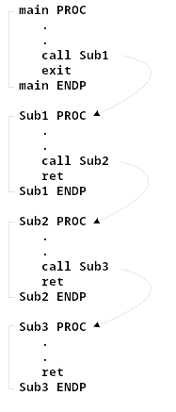
Nested Procedure Calls
By the time Sub3 is called, the stack contains all three return addresses:
Irvine, Kip R. Assembly Language for x86 Processors 7/e, 2015.

Slide 33
Local and Global Labels
A local label is visible only to statements inside the same procedure. A global label is visible everywhere.
main PROC
jmp L2 ; error
L1:: ; global label
exit
main ENDP
sub2 PROC
L2: ; local label
jmp L1 ; ok
ret
sub2 ENDP
Irvine, Kip R. Assembly Language for x86 Processors 7/e, 2015.

Slide 34
Procedure Parameters (1 of 3)
A good procedure might be usable in many different programs
  but not if it refers to specific variable names
Parameters help to make procedures flexible because parameter values can change at runtime
Irvine, Kip R. Assembly Language for x86 Processors 7/e, 2015.

Slide 35
Procedure Parameters (2 of 3)
The ArraySum procedure calculates the sum of an array. It makes two references to specific variable names:
ArraySum PROC
  mov esi,0 ; array index
  mov eax,0 ; set the sum to zero
mov ecx,LENGTHOF myarray ; set number of elements
L1: add eax,myArray[esi] ; add each integer to sum
  add esi,4 ; point to next integer
  loop L1 ; repeat for array size
  mov theSum,eax ; store the sum
ret
ArraySum ENDP
Irvine, Kip R. Assembly Language for x86 Processors 7/e, 2015.

Slide 36
Procedure Parameters (3 of 3)
This version of ArraySum returns the sum of any doubleword array whose address is in ESI. The sum is returned in EAX:
ArraySum PROC
; Receives: ESI points to an array of doublewords,
; ECX = number of array elements.
; Returns: EAX = sum
;-----------------------------------------------------
  mov eax,0 ; set the sum to zero
L1: add eax,[esi] ; add each integer to sum
  add esi,4 ; point to next integer
  loop L1 ; repeat for array size
ret
ArraySum ENDP
Irvine, Kip R. Assembly Language for x86 Processors 7/e, 2015.

Slide 37
Summary
Procedure – named block of executable code
Runtime stack – LIFO structure
  holds return addresses, parameters, local variables
  PUSH – add value to stack
  POP – remove value from stack
Irvine, Kip R. Assembly Language for x86 Processors 7/e, 2015.

Slide 38

55 64 67 61 6E 67 65 6E
Irvine, Kip R. Assembly Language for x86 Processors 7/e, 2015.

